Slide 1
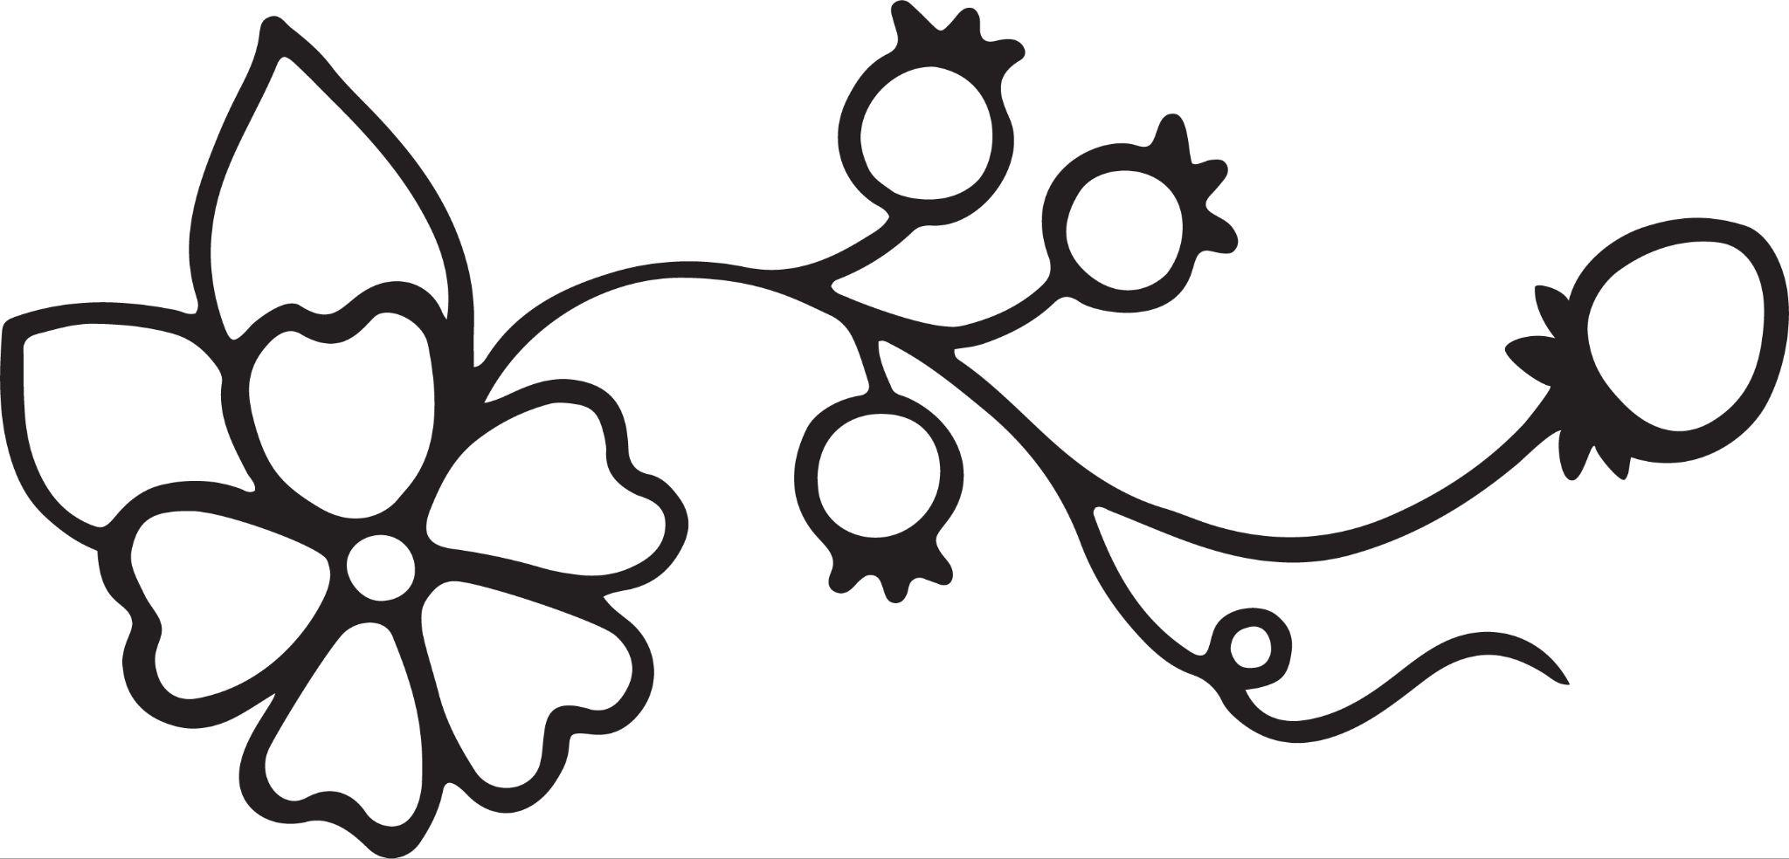
Medicine Pouch Making
Mashkiki-Mashkimodens Ozhitoon

Slide 2
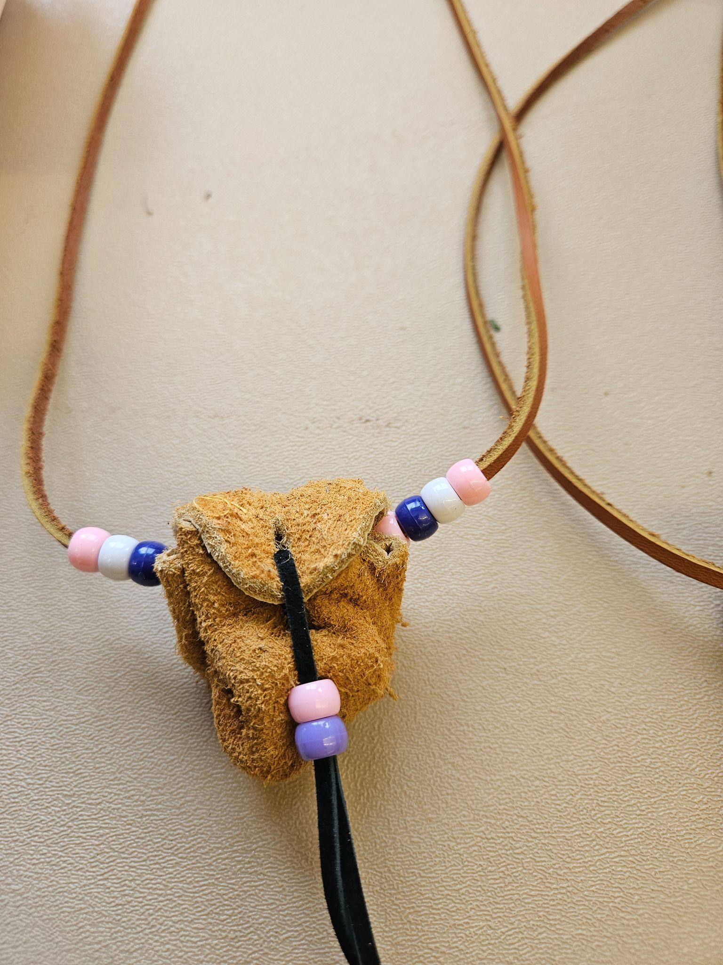
What is a medicine pouch?
A device used to carry your medicine of course!
You can also use it to put special items in such as:
Rocks, coins, plants, or anything you can think of!

Slide 3
American Indian Uses
The Ojibwe tribal members often use medicine pouches to carry tobacco in. They use tobacco as gifts to each other when asking important questions or making promises. Tobacco is also put out in the woods as an offering to the spirits when asking for guidance or help. Some tribes also use medicine pouches like a good luck charm.
The most common medicines put in pouches by the Ojibwe people are cedar, tobacco, sage and sweetgrass.

Slide 4
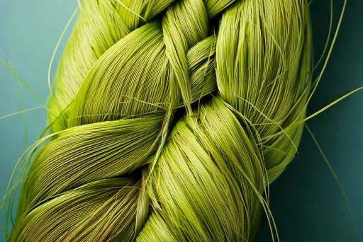
Sweet grass - wiingashk
Sweetgrass is a sacred plant for many Indigenous peoples in North America, primarily used in ceremonies and for purification. It's often braided and burned as a smudge, with the fragrant smoke believed to cleanse spaces and spirits, and to attract positive energies. Additionally, sweetgrass is used in basket weaving and, historically, in some medicinal applications.

Slide 5
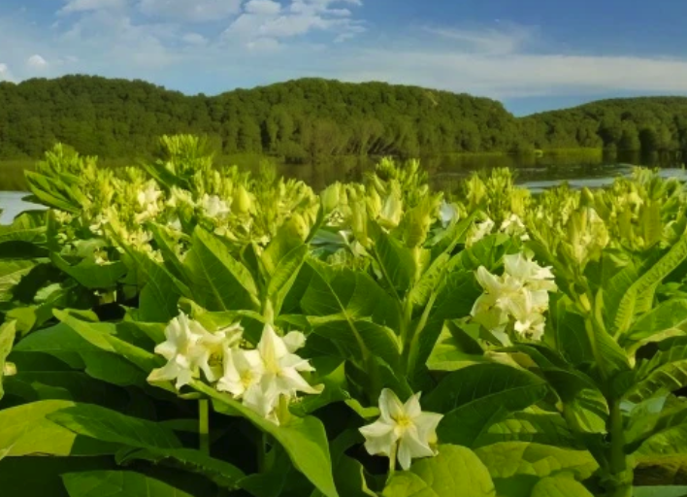
Tobacco - asemaa
Tobacco, a plant with a complex history, has been utilized in diverse ways across cultures. While its commercial use is now primarily associated with smoking, its traditional uses are significant. Indigenous peoples of the Americas employed tobacco in sacred ceremonies, for medicinal purposes, and in social rituals, viewing it as a powerful and respected plant. Beyond these traditional uses, tobacco has also been the source of nicotine, a stimulant that has led to widespread commercial production of cigarettes and other tobacco products. It is important to note that modern medical science has shown that the consumption of tobacco products has very serious negative health consequences.

Slide 6
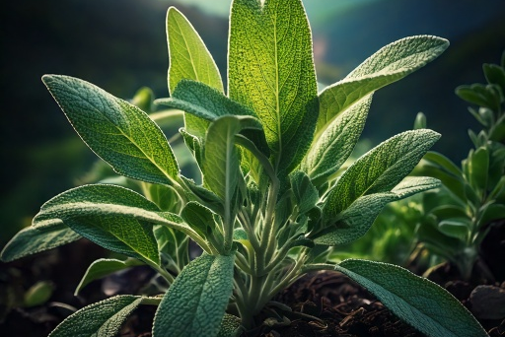
Sage - bashkodejiibik
Sage, a versatile herb, holds significance in both culinary and medicinal realms. Traditionally, it's been used by various cultures, including Indigenous peoples, for purification rituals, often by burning the dried leaves in a practice known as smudging. Beyond spiritual uses, sage is valued for its potential health benefits, with studies exploring its effects on cognitive function, cholesterol levels, and menopausal symptoms. In the kitchen, sage adds a distinct, earthy flavor to a wide range of dishes, from savory meats to flavorful sauces.

Slide 7
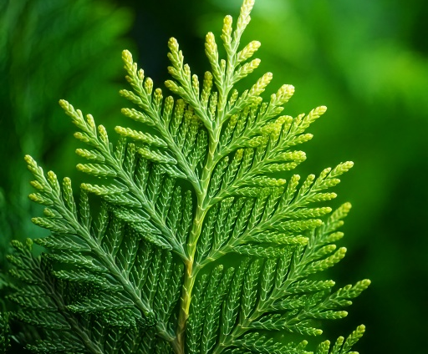
Cedar - giizhik
Cedar, with its aromatic wood and foliage, has a long history of use across various cultures. Indigenous peoples of North America traditionally burn cedar for purification and cleansing ceremonies, believing its smoke carries prayers to the Creator and wards off negative energies. The wood's natural oils also make it resistant to decay, leading to its use in construction and crafting. Additionally, cedar's essential oil is utilized in aromatherapy and traditional medicine for its potential antiseptic and respiratory benefits.

Slide 8
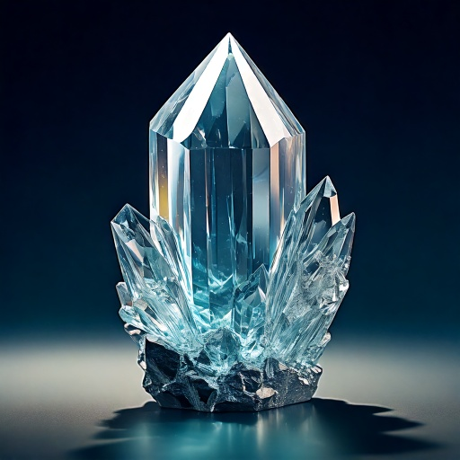
Other items to put in your medicine pouch
Stones and crystals: These can represent various energies or healing properties.
Animal parts: Feathers, claws, teeth, or fur can symbolize specific animal spirits or characteristics.
Seeds and other plant materials: Beyond the four sacred medicines, other herbs, flowers, or seeds may be included for their medicinal or symbolic value.
Earth: small amounts of earth from sacred locations.
Rock - Asin

Slide 9
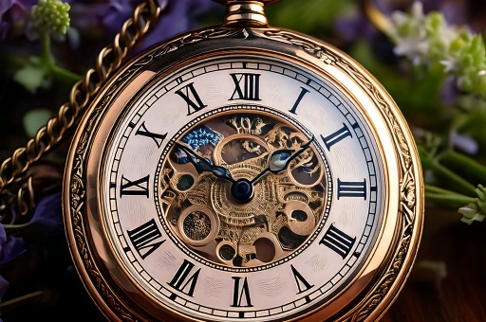
continued
Personal talismans: These could be objects that hold special meaning or provide protection.
Small tools: such as small knives, or other important tools.
Family heirlooms: Items passed down through generations.
Objects representing the four directions: Items that represent the north, south, east, and west.
Objects representing the elements: Items that represent earth, air, fire, and water.
Watch- diba'igiiziswaanens

Slide 10
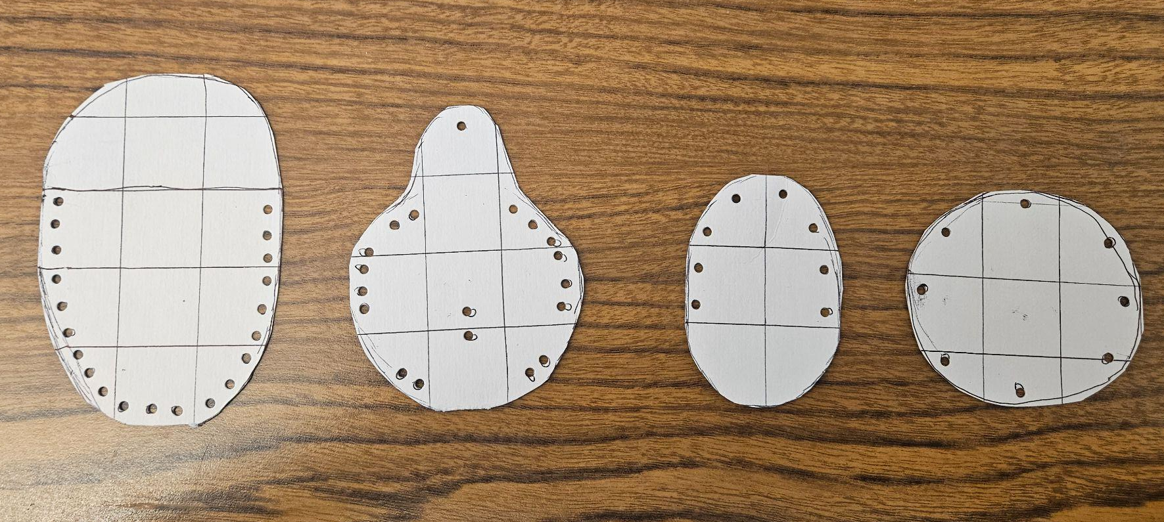
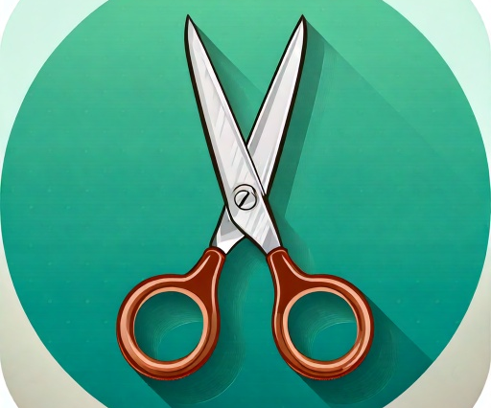
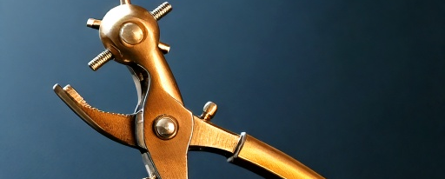
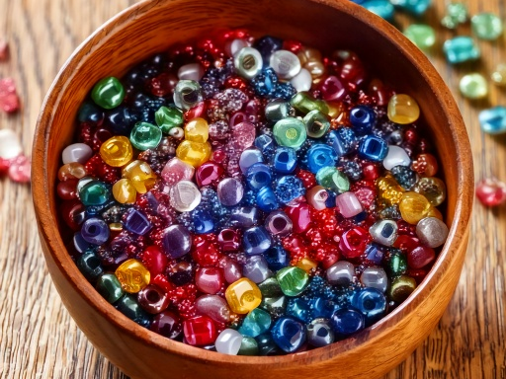
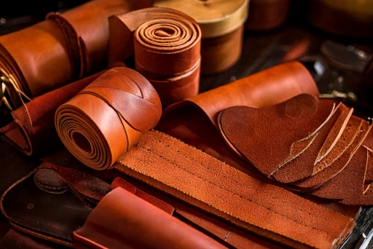
Time to start making our own !
Medicine pouch template
Naabizhigan (pattern)
Pony Beads
manidoominens
We will be using:
Scissors
moozhwaagan
Leather hole punch
aabajichigan (tool)
Leather
bashkwegin

Slide 11
Video Tutorial
The Red Barn - Six Nations
https://www.youtube.com/watch?v=moomVzC1JXg

Slide 12

Have fun !
Mnowaangozi

Slide 13
Resources
Medicine Pouch Resources
First nations medicine pouch
https://www.youtube.com/watch?v=NWzWpQmR5uU
2 ways to make a pouch
https://www.youtube.com/watch?v=moomVzC1JXg
In Depth Instructions
https://www.instructables.com/Leather-Medicine-Bag-or-Pouch/
Tanning leather
https://www.youtube.com/watch?v=xnkO6FfScvY
Leather alternatives
https://www.youtube.com/watch?v=NF6NcIjz1tI
Cedar Resources
Making Cedar tea
https://www.indigenousaware.com/post/cedar-tree-tea-benefits
White Sage Resources
White Sage species guide
https://tallgrassprairiecenter.org/native-seed-production-manual/species-production-guides/forbs/white-sagebrush
Sweet Grass Resources
How to identify sweetgrass
https://www.wikihow.com/Identify-Sweetgrass
Sweetgrass basket weaving
https://www.youtube.com/watch?v=Cjk9SMEXVLw
Tobacco Resources
Uses of tobacco
https://www.youtube.com/watch?v=UYvKVEoY8u0
Growing your own tobacco
https://oneida-nsn.gov/wp-content/uploads/2016/04/09.06.22-Native-Tobacco.pdf

